Slide 1

Hadoop: Impala, HBase, Spark, Solr, Oozie

Slide 2
Impala Introduction

Slide 3

What Is Impala?
Impala is an interactive SQL-like query engine for Hadoop
Query data are loaded into memory on each worker node to improve processing—MPP architecture
Requires a lot of RAM on each worker node to work effectively
Impala is an open source created by Cloudera
Hortonworks has the Stinger initiative—add on to Hive
Top-level open source project in 2017

Slide 4
Impala vs. Hive
Impala
Hive
Interactive SQL over Hadoop
Processes queries in memory on worker nodes
Working data loaded into memory for faster query times
Does not generate MapReduce jobs
Batch SQL over Hadoop
Processes queries via MapReduce
Working data remain on disk
Query generates a MapReduce job

Slide 5
Impala Architecture
Impala avoids latency by accessing HDFS data through its own query engine installed on each of the worker nodes.
Common Hive SQL and interface
Unified metadata
SQL App
Hive Metastore
HDFS NN
State Store
ODBC
Query Planner
Query Planner
Fully MPP Distributed
Query Planner
Query Coordinator
Query Coordinator
Query Coordinator
Query Exec Engine
Query Exec Engine
Query Exec Engine
HDFS DN
HBase
HDFS DN
HBase
HDFS DN
HBase
Local Direct Reads
Notes:
This is similar to how most commercial MPP systems work.

Slide 6
Demo: Impala vs. Hive
Introduce Impala.
$ impala-shell
Let’s check out the query times for Impala vs. Hive for a simple aggregate query.
select state, count(*) from zips group by state having count(*) > 2000 order by state;
Notes:
select state, count(*) from zips group by state having count(*) > 2000 order by state;
20 seconds on hive…. With a map-reduce
Second time to query ….
Still 20 seconds
5 seconds on impala
Second time to query
Less than a second.

Slide 7
Metadata Caching

Slide 8
Metadata Caching
It is the reason the Impala queries improve from the first query to the next.
Each Impala worker node maintains a copy of Hive Metastore metadata.
This metadata contains information about the table definition, data format, and block storage in HDFS.
As a result, table changes in Hive or updates to the underlying data in HDFS or HBase will go unnoticed by Impala.

Slide 9
REFRESH statement
Re-caches the Hive Metastore data into the Impala worker nodes
Must be done whenever:
New files are loaded into an HDFS folder for the Hive table
The following Hive commands are executed: ALTER TABLE, INSERT, or LOAD DATA
REFRESH tablename;

Slide 10
INVALIDATE METADATA
Marks the metadata for one or all tables as stale
Next time a query uses an invalidated table, the Hive metadata is reloaded
More costly than a REFRESH but also works at the system and database levels
INVALIDATE METADATA [database][.table];
Notes:
More costly than a refresh because the time to load metadata occurs at query time, not when the refresh statement occurs.

Slide 11
Demo: Stale Metadata
Query table in Impala
Load additional data into an external table through HDFS
Query it in Hive—new data are there
Query it in Impala—new data are not there!
Refresh table
Query it again—data are there

Slide 12

What is Hbase?

Slide 13

What Is HBase?
A column-oriented database
Stores data on top of HDFS; uses HDFS for storage
Based on Google Bigtable paper
No schema required
Supports CRUD operations, and consistent reads
Like HDFS, HBase is a single-master system

Slide 14
Row Store vs. Columnstores
Row Store
Columnstore
Rows stored together in the database
Data stored/retrieved one row at a time
Inefficient when only a few columns are accessed
Can update all values in a row
Columns stored together in the database
Data stored/retrieved a column at a time
Efficient when only a few columns are accessed
Can only update a single value at a time

Slide 15
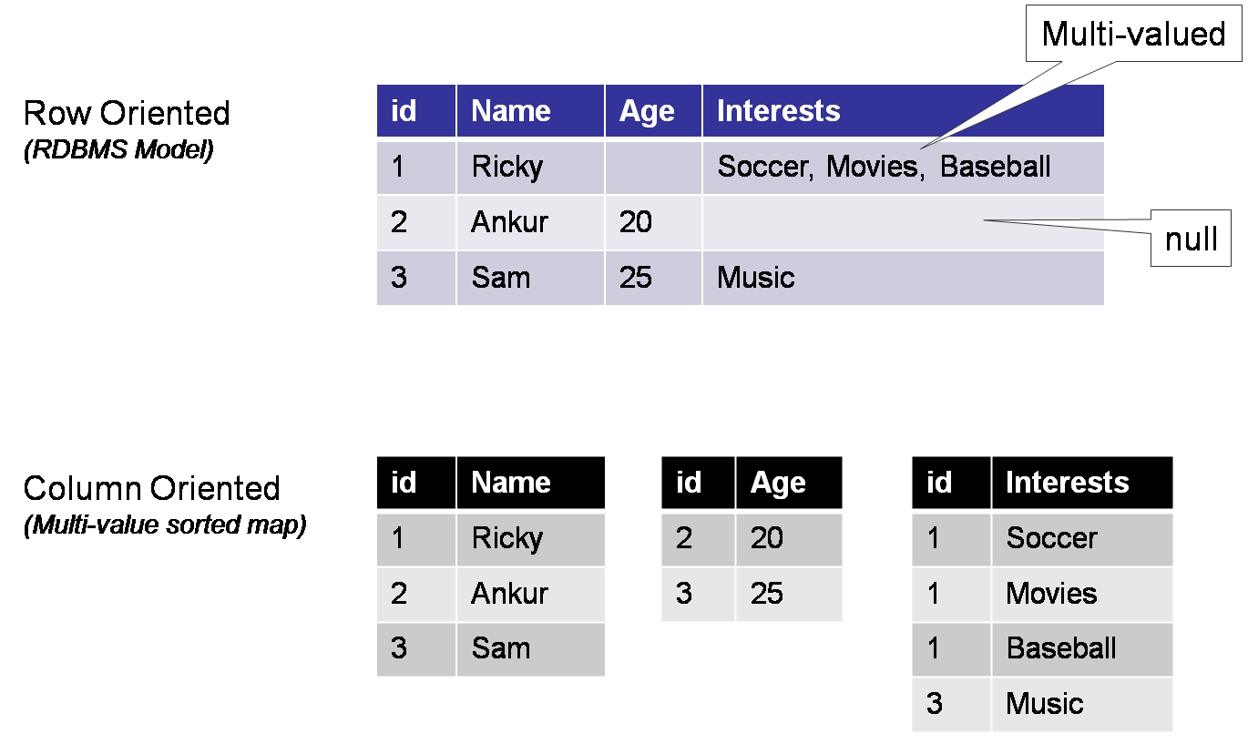
Row vs. Column Oriented

Slide 16
HBase vs. HDFS
HDFS
HBase
Is suited for high-latency operations batch processing
Data are primarily accessed through MapReduce
Is designed for batch processing and hence doesn’t have a concept of random reads/writes
Is built for low-latency operations
Provides access to single rows from billions of records, supporting random reads/writes
Data are accessed programmatically through shell commands, client APIs in Java, REST

Slide 17
HBase Use Cases and Architecture

Slide 18
Hbase Use Cases
Application storage requires a variable schema
Example: you need to store columns that are determined at run-time
Data keyed on the same value
Example: messages like emails, texts, or blog comments
Wide data with many null values in columns
Example: tables with several columns, like survey data

Slide 19
Don’t Use HBase When…
Your data aren’t big enough! Close to a billion rows…
Unless you are feeling the pain from your RDBMS, there’s no reason to abandon it for a system without:
Indexes
Type columns
Integrity constraints
A Query language!
Notes:
Or any NOSQL Database for that matter.

Slide 20
HBase Architecture
HMaster
Monitors the region servers
Controls load balancing and failover
Assigns regions to region servers
HRegionServer
Installed on Hadoop worker nodes
Consists of multiple regions, called HRegions
Each HRegion consists of multiple data stores where the data are written
HMaster
HRegion Server1
HRegion Server2
HRegion Server3
HRegion Server4

Slide 21
HBase Data Model Visualized
HRegionServer
HRegions
Tables
HFiles
Column families
Cell
Notes:
READ THIS!!!!
Here’s an example of a single region server in a Hbase cluster.
The HRegionServer has multiple regions
Tables – Logical collection of rows stored in HRegions. A single table is distributed across several regionservers.
Rows – A row is one instance of data in a table and is identified by a rowkey. Rowkeys are unique in a Table.
Column Families – Data in a row are grouped together into Column Families, which are groups of columns.
Columns in a family are stored together in a low level storage file known as HFile. Column Families form the basic unit of physical storage to which certain HBase features like compression are applied. Hence it’s important that proper care be taken when designing Column Families in table. They should be grouped physically, not logically.
Columns – A Column Family is made of one or more columns. A Column is identified by a Column Qualifier that consists of the Column Family name concatenated with the Column name using a colon – example: columnfamily:columnname. There can be multiple Columns within a Column Family and Rows within a table can have varied number of Columns.
Cell – A Cell stores data and is essentially a unique combination of table, rowkey, Column Family and the Column (Column Qualifier). The data stored in a Cell is called its value and the data type is always treated as an array of bytes.
Version – The data stored in a cell is versioned and versions of data are identified by the timestamp. The number of versions of data retained in a column family is configurable and this value by default is 3.

Slide 22
HBase Logical Data Model
Table: collection of rows and columns
RowKey: access to columns by row key
Column Family: a collection of columns physically stored together
Cell: the most atomic unit in HBase—a cell, row, column family, and column; every cell has a timestamp and value
>> get 'customers', 1, 'address:street'
timestamp=1533254769041, value=314 Hinds Hall
Table
RowKey
Column Family
Column

Slide 23
HBase Table Commands

Slide 24
HBase Shell
$ hbase shell
To access the HBase shell
It’s not the common way to access HBase; most use cases for HBase are by applications—not by users
Notes:
# hbase shell

Slide 25
Table Commands
List—show tables
Create—create a table
Alter—add a column family to a table
Disable—disable a table
Drop—drop a table
Get_table—get a table reference

Slide 26
Commands or Table Reference
Commands can be issued with table name or using a reference.
> create 'demotable', 'myfamily' > disable 'demotable' > drop 'demotable'
With table references:
> d = create 'demotable', 'myfamily' > d.disable > d.drop

Slide 27
Demo: HBase Shell & Table Commands
Status command
Whoami
Version
Table commands
Table references
Notes:
$ hbase shell
Hbase> Whoami
Hbase> Version

Slide 28
Demo: HBase reading and writing data

Slide 29
HBase Cell Commands
Put—write to a cell
Get—read from a cell
Delete—delete a cell
Scan—omit the contents of a table

Slide 30
Demo: HBase Reading / Writing Data
Create customer table with address column family
Put some data for customer 1
Put some data for customer 2
Scan
Get columns
Get data
Describe a table
Notes:
Create ‘customers’, ‘address’
Put ‘customers’, 1, ‘address:street’, ‘ 314 Hinds Hall’
Put ‘customers’, 1, ‘address:city’, ‘ Syracuse’
Put ‘customers’, 1, ‘address:state’, ‘ NY
Put ‘customers’, 2, ‘address:street’, ‘ 221b Baker Street’
Put ‘customers’, 2, ‘address:city’, ‘ London’
Put ‘customers’, 2, ‘address:country’, ‘ UK
Scan ‘customers’
Get ‘customers, 1
#not there is no way to get columns from customer 1 and 2. You must get my key first.
get 'customers',1, ['address:city', ‘address:state]
Alter ‘customers’, ‘name’
Put ‘customers’, 1, ‘name:first’, ‘Mike’
Put ‘customers’, 1, ‘name:last’, ‘Fudge’
Put ‘customers’, 1, ‘name:suffix’, ‘Jr’
get 'customers',1, [‘name:first, ‘address:city]
scan 'customers' , { COLUMNS => [ 'address:city'] }

Slide 31
Integrating HBase with Hive

Slide 32
Integrating HBase With Hive
Can be integrated two ways:
Existing HBase tables can be external tables in Hive.
New HBase tables can be created in Hive and data loaded into them with HQL.
Use the HBaseStorageHandler
Must set the special serializer/deserializer mappings, SERDEPROPERTIES

Slide 33


HBase and Hive
Metastore
Hive
HBase
HDFS
Notes:
Both Hive and HBase use HDFS as their underlying file system.
We know Hive uses the metastore already.
Hbase integration occurs when we connect Hbase tables to the metastore, allowing us to query the tables with any Hadoop system which supports the metastore… like Impala for example!

Slide 34
Demo: HBase to Hive, Then Impala
Create external table in Hive from the HBase table customers.
Query it in Hive!
Query it in Impala!
Notes:
create external table customers_hbase(key int, street string, city string, state string, country string) stored by 'org.apache.hadoop.hive.hbase.HBaseStorageHandler'
> WITH SERDEPROPERTIES("hbase.columns.mapping" = "address:street,address:city,address:state,address:country") TBLPROPERTIES("hbase.table.name"="customers");
select * from customers_hbase;
Back to Hbase
put 'customers', 3, 'address:street', '1313 Mockingbird lane’
Back to hive
select * from customers_hbase;

Slide 35
Demo: Hive to HBase
Hive tables are a great way to load data into HBase using HQL.
Let’s create the Hive table in HBase.
Use HQL to load data into the table.
Query it in HBase!
Notes:
create table grades_hbase (course string, year int, term string, credits int, letter string) STORED BY 'org.apache.hadoop.hive.hbase.HBaseStorageHandler'
> WITH SERDEPROPERTIES ("hbase.columns.mapping"=":key, g:year, g:term, g:credits, g:letter") TBLPROPERTIES("hbase.table.name"="grades")
> ;
insert into grades_hbase select course, year, term, credits, letter from grades;
Select * from grades_hbase;
TO HBASE
scan 'grades', { COLUMNS => [ 'g:letter'] }

Slide 36

Other Tools
In the Hadoop ecosystem
In the Hadoop ecosystem

Slide 37
Oozie

Slide 38
Oozie
Oozie is a workflow scheduler for Hadoop
You can create workflows and then schedule them
Has support for Hive, Pig, Flume, Sqoop, and more
Syntax of Oozie files are XML—not easy to edit directly
Analogous to SQL Server Agent + Integration Services, or IFFT

Slide 39
Oozie Concepts
Workflow: jobs specifying a sequence of actions to execute
Coordinator: jobs are recurrent Oozie Workflow jobs that are triggered by time and data availability
Bundles: packages of Workflow + Coordinator jobs
Bundle
Coordinator
Workflow

Slide 40
Workflow Example: Customer Web Analytics
Shell script: import new Log file into HDFS
Pig: remove Log errors, geolocate
Impala: refresh table
Hive: load Pig output into internal table with Parquet file

Slide 41
Coordinator
Coordinator
Bundle
Schedule a Workflow to run:
Daily
Hourly
Weekly
Monthly
Yearly
A collection of Coordinators managed together
Can start in parallel or in series

Slide 42
Spark

Slide 43

Spark
General-purpose data-processing/computing engine
Developed at UC Berkeley AMP Lab
Step up from Hive and Pig, which are still batch-oriented
Stores working data in memory for fast processing (RDDs and data frames)
Best-suited machine learning tasks and interactive/exploratory analytics
APIs/language support for Python, Scala, Java, and R

Slide 44
Spark Libraries
Four libraries built on Spark Core
MLlib: a machine learning library
Spark Streaming: enables high-throughput, fault-tolerant stream processing of live data streams
Spark SQL: runs SQL and HiveQL queries, accesses Metastore
GraphX: an API for graphs and graph-parallel computation
Spark SQL
Spark Streaming
MLlib (machine learning)
GraphX (graph)
Apache Spark

Slide 45
Spark Architectural Components
Worker Node
Executor
Cache
Driver Program
Task
Task
Spark Context
Cluster Manager
Worker Node
Executor
Cache
Task
Task
Spark applications are similar to Pig scripts in the sense that a Spark application defines various transformations and actions on data, but the actual steps of the script are not executed until an output is requested.
Notes:
Same Delayed Execution Model as Pig

Slide 46
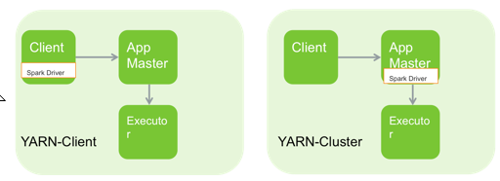
Spark Deployment Modes
Standalone
For sandboxed/development environments
Spark on YARN (two modes)
Spark Driver on Client
Spark Driver on Cluster—useful for low latency between client and cluster
Notes:
Since Spark was developed at UC Berkeley it can run without a Hadoop cluster or so called standalone mode. However when integrated with YARN as in HDP, there are two modes to choose. In local mode the spark code runs on the client machine (aka utility server/edge node/gateway server). In cluster mode, spark code is managed inside an application manager. The next several slides will detail these architectures.

Slide 47
Spark vs. MapReduce
Why is Spark faster?
Caching data to memory can avoid extra reads from disk
Scheduling of tasks from 15–20 s to 15–20 ms
Resources are dedicated the entire life of the application
Can link multiple maps and reduces together without having to write intermediate data to HDFS
Every reduce doesn’t require a map
Like Impala, requires a lot of memory per worker—128 GB
Notes:
Spark is faster than MapReduce for several reasons. First, and the biggest, is Spark can cache data into memory. Reading from memory is measured in nanoseconds, reading from disk is measured in milliseconds. Quite the increase in speed is seen from there. In addition, the scheduling of tasks in Spark has greatly decreased from MapReduce. Spark has dedicated resources, so scheduling of tasks doesn’t require a resource request. Because of this, scheduling has gone from 15-20s to 15-20ms. In spark, you can have multiple reduces and maps in a row. You do not need a map phase for every reduce phase. Skipping this extra map save reading and writing data to disk.

Slide 48
Solr

Slide 49

Solr
Standalone, full-text search engine based on Apache Lucene
Provides distributed search engine over your HDFS data
Simple, powerful UI
High-performance indexing and fast search results
Indexes are sharded over the Hadoop worker nodes for performance

Slide 50
What Does Solr Do for Hadoop?
Imagine searching through mountains of data quickly
Customer reviews
Customer tweets
Application logs
Surveys and evaluations
With ad-hoc queries
Which customers said a particular product was “unsafe”?
When did event error 345 occur in my logs?
Which someone used the phrase “missing cat” in their Tweet?

Slide 51
Demo: Cloudera Search
Cloudera search allows you to build Solr indexes and then create dashboards to search the data.
Create index
Create an index from HDFS data
Search: Twitter Dashboard
Check the file
Check the index
Dashboard searches
Text
Filters
Search: Yelp reviews Dashboard
Maps
Notes:
Search examples:
New York >> New or York
“New York” Cat >> “New York” or Cat
+"New York" +cat >> both terms
+missing +cat
Like
Then use built in filters
THEN SWITCH TO YELP REVIEWS
User_location: London

